Slide 2
The Old Kingdom began 2600 BC and ended 2300 BC.
During that time cities grew and trade expanded.
Kings set up strong governments.

Slide 3
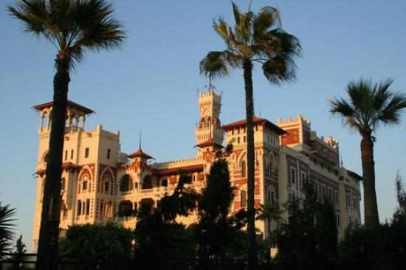
Egyptian kings were known as pharaohs.
They lived with their families in grand palaces.
Pharaohs appointed many officials to do their work collecting taxes, see to it that crops were planted, irrigation canals dug, and food stored.

Slide 4
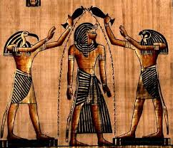
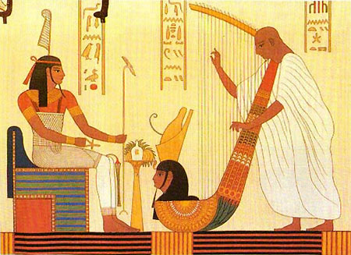
Egyptians thought their pharaoh was a god.
He carried out certain rituals that were believed to benefit the kingdom.

Slide 5
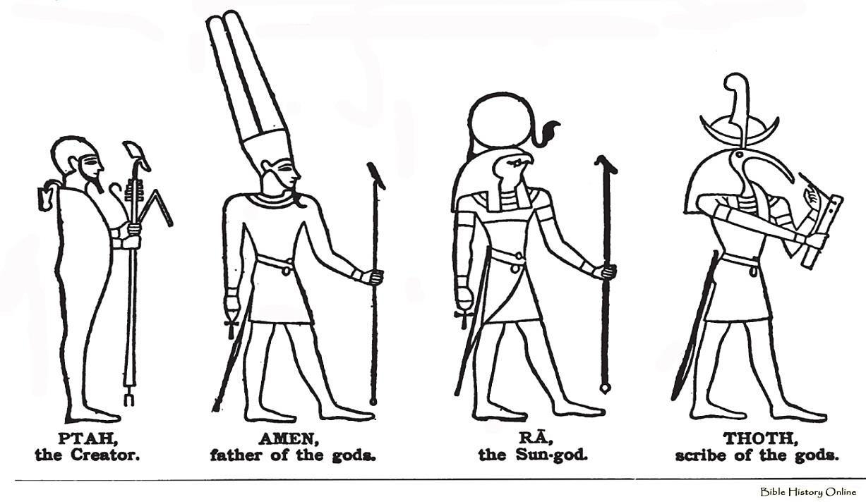
Religion
Religion was deeply woven into Egyptian culture.
Ancient Egyptians worshipped many deities.
The main Egyptian god was Re.
The most important goddess was Isis.

Slide 6
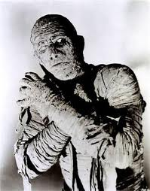
Uh oh!
Not again!
Egyptians took a hopeful view of the after-life.
To protect Pharaoh’s body it was embalmed. Then wrapped in linen.
The wrapped body was known as a mummy.
The mummy was placed in several wooden coffins, one inside the other, then buried in a tomb.

Slide 9
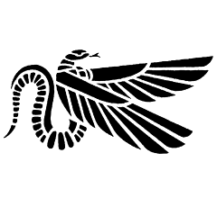
Medicine
While embalming the dead, the Egyptians learned much about the human body.
Doctors learned about illnesses and setting broken bones.
Some doctors became “specialists” in certain kinds of medicine.
Egyptians wrote the first medical books on scrolls of papyrus.

Slide 10
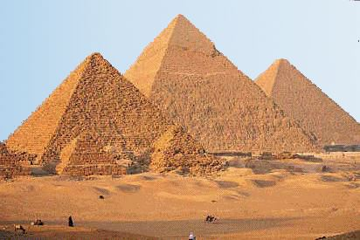
Pyramids
No ordinary tomb would do for a Pharaoh.
Mountain-like monuments called pyramids were built for the Pharaoh’s tomb.

Slide 13
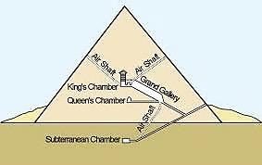

Slide 14
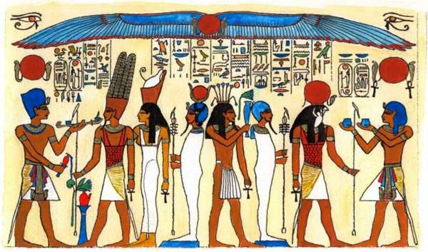
Ancient Egyptian Mathematics
Ancient Egyptians had to figure out how many blocks it took to build a pyramid. This lead to advancements in which field of mathematics?
Algebra
Trigonometry
Geometry
Calculus

Slide 15
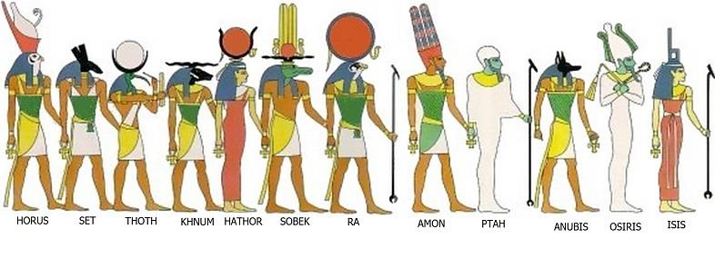
Good, That Is Correct!
Geometry is the study of “Earth-Measure,” and includes the study of shapes, angles, and their relationships. The ancient Egyptians used geometry to survey their land and build the pyramids and monuments.

Slide 16
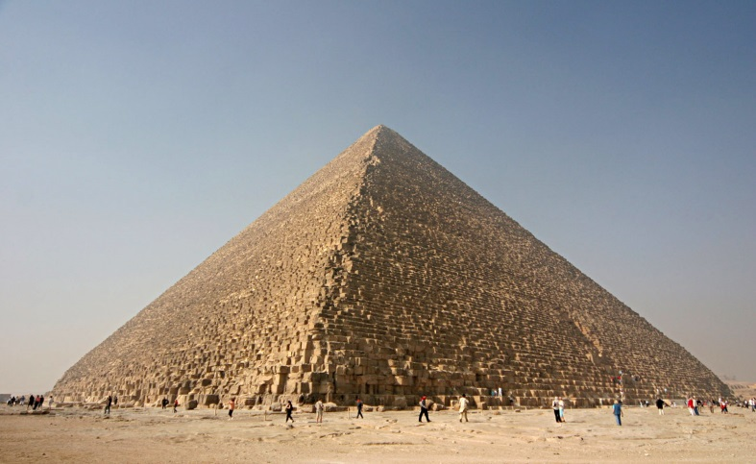
The Great Pyramid
About 2540 BC, the Egyptians built the largest and grandest pyramid known as the Great Pyramid.
It was built for King Khufu.
It was the tallest structure in the world for 4000 years!
It is equal to a 48 story building.

Slide 17
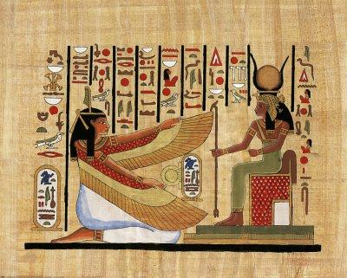

Slide 18
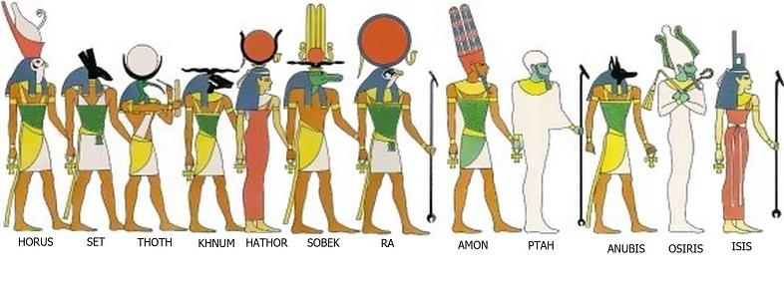
I’m Sorry, that’s incorrect!
Return

